Slide 1
LabVIEW FPGA

Slide 2

What You Need To Get Started
LabVIEW FPGA Exercise Manual
LabVIEW FPGA Course CD
LabVIEW FPGA Course Manual
NI Sound and Vibration Signal Simulator
Two J-type thermocouples
NI 9074 Integrated Controller or equivalent
NI 9211, 9233, and 9263 Modules
Computer running Windows 7/Vista/XP with the following software installed:
LabVIEW 2010 or later
LabVIEW Real-Time
LabVIEW FPGA
NI-RIO 3.5.0 or later

Slide 3

File Locations
Root Directory
Exercises <or> Solutions
LabVIEW FPGA
The course installer places the course files in the following location:

Slide 4
Instructional Methods
Lecture
Topic
Quizzes
Demonstrations
Concept Exercise
Development Exercise
Notes:
Lecture gives a foundation in the topic
Instructor reinforces foundation through demonstrations and quizzes
Use concept exercises to further explore a topic
Watch a simulation, experiment with example VIs
Use development exercises to gain hands-on experience
Demonstration of a finished development exercise further reinforces the learning process

Slide 5
Getting The Most Out Of This Course
Ask questions!
Experiment with hands-on exercises to understand the methods used
Explore solutions
Implementations explore a possible solution—you may find a better one

Slide 6
New User Experienced User Advanced User
LabVIEW Core 1
LabVIEW Core 2
LabVIEW Core 3
Managing Software Engineering in LabVIEW
Advanced Architectures in LabVIEW
LabVIEW Connectivity
Object-Oriented Design and Programming in LabVIEW
LabVIEW Performance
Certifications
Certified LV Associate Developer Exam
Certified LabVIEW Developer Exam
Certified LabVIEW Architect Exam
Other Courses
LabVIEW Real-Time 1
LabVIEW Real-Time 2
LabVIEW FPGA
DAQ & Signal Conditioning
LabVIEW Instrument Control
LabVIEW Modular Instruments
LabVIEW Machine Vision
RF Fundamentals
RF Application Development

Slide 7
Course Learning Map
Lesson 1
FPGA Programming Basics
Lesson 4
Lesson 2
Introduction to LabVIEW FPGA
LabVIEW FPGA Basics
Lesson 3
FPGA I/O
Lesson 5
Single-Cycle Timed Loops
Lesson 8
Lesson 6
Loop Execution and Data Sharing
Data Sharing on FPGA
Lesson 7
Basic Host Integration – PC/Real-Time
Lesson 9
Lesson 10
DMA Data Transfers
Modular Programming

Slide 8
Course Goals
This course prepares you to:
Select and configure NI Reconfigurable I/O (RIO) hardware
Create, compile, download, and execute a LabVIEW FPGA VI and use NI RIO hardware
Perform measurements using analog and digital input and output channels
Create host computer programs that interact with FPGA VIs
Understand and control timing of operations on the FPGA target
Design and implement applications using the LabVIEW FPGA module
Notes:
Refer to the Course Outline posted on ni.com/training.

Slide 9
Configuring Your LabVIEW Environment
Options Dialog Box
Controls/Functions Palettes page
Select Load palettes during launch to make Search Palettes immediately usable after launch
Set Palette to Category (Icons and Text)
Block Diagram page
Uncheck Place front panel terminals as icons to place control and indicator terminals in a compact format
Configure Block Diagram Cleanup to customize your block diagram
Notes:
This is an opportunity before the class starts for individuals to customize their environment with their favorite settings. The settings noted in the slide are suggested changes.
Other possible suggested changes based on instructor discretion:
Check Environment > General > Skip Getting Started window on launch
Uncheck Block Diagram>>Error Handling>>Enable automatic error handling in new VIs

Slide 10
Configuring Your LabVIEW Environment
Functions Palette
Tack the Functions palette and select View»Change Visible Categories then click Select All
Controls Palette
Tack the Controls palette and select View»Change Visible Categories then click Select All
Notes:
Functions Palette (Block Diagram)
Tack the Functions palette and click CustomizeView»Change Visible Palettes then click Select All
Controls Palette (Front Panel)
Tack the Controls palette and click CustomizeView»Change Visible Palettes then click Select All
Make inputs on subVIs required

Slide 11
Lesson 1 Introduction to LabVIEW FPGA
Introduction to FPGA Technology
LabVIEW FPGA System
Comparison with a DAQmx System
LabVIEW FPGA Applications
Notes:
Lesson objectives:
Understand that FPGA is reconfigurable hardware whose logic is defined in software
Understand some benefits of reconfigurable hardware
Understand that a LV FPGA system is comprised of two parts: HW and SW
Understand that no operating system runs on FPGA
Understand that you do not need to know Verilog or HDL to program LabVIEW FPGA
Identify applications for which LabVIEW FPGA is ideally suited
Understand differences in processing and reliability between traditional system and FPGA system

Slide 12
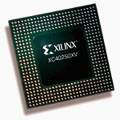
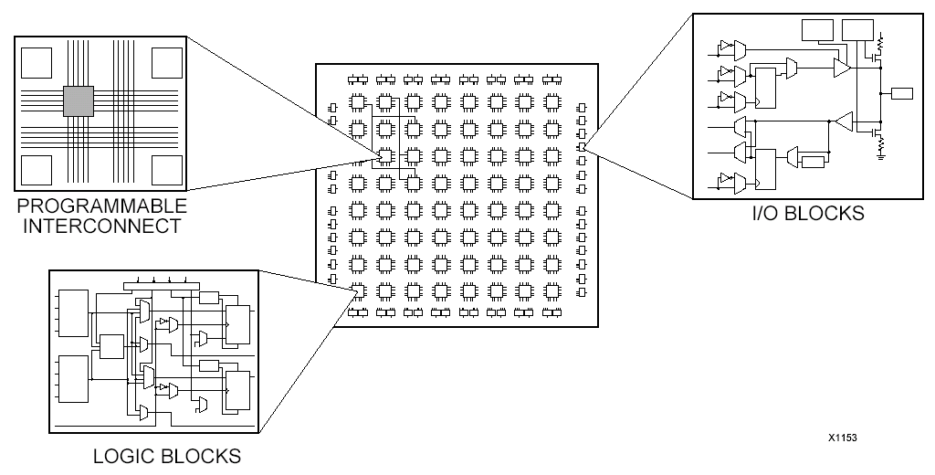
A. Introduction to FPGA Technology
What is an FPGA?
Field programmable gate array (FPGA)
A silicon chip with unconnected gates and other hardware resources
Enables user to define and re-define functionality
How does an FPGA work?
Circuit behavior is defined using software
Circuit specification (gate connection, etc.) is loaded into the hardware
No OS is needed for execution of logic
When is an FPGA used?
Custom hardware, where it doesn’t make sense to pay the high price of developing an ASIC
Reconfiguration required after deployment
Notes:
Introduction to FPGA Technology
Begin by discussing the technology behind LabVIEW FPGA.
Field programmable gate arrays (FPGAs) are silicon chips with unconnected logic gates. You can define the functionality of the FPGA by using software to configure the FPGA gates. FPGAs are often used as processing components in low to medium volume electronics, where the time and cost of developing and fabricating an applications specific integrated circuit (ASIC) is prohibitive. FPGAs are also found in applications that require reconfiguration in the field. Basically, FPGAs are used when customers need custom I/O hardware but also want commercial off the shelf (COTS) hardware.

Slide 13
Benefits of FPGA
Flexibility
Reconfigurable through software
True parallel processing
Simultaneous parallel circuits
No CPU time sharing
High Performance
Reliability
Offload processing
Cost
Notes:
It is important to understand the benefits of FPGAs. FPGAs are reconfigurable through software, making them very flexible. Unlike a microprocessor or application specific integrated circuit (ASIC), FPGAs can have their functionality modified even after being deployed in an application. FPGAs can also execute specific tasks very efficiently within silicon. Since FPGA execution is controlled by the programmable interconnects, users can implement truly parallel tasks within the FPGA that will execute simultaneously and independent of one another. Finally, since applications are actually implemented in hardware without any software involved such as an operating system, FPGAs provide the ultimate in execution reliability.
----------------------
Flexibility:
Reconfigurable through software. Create a chip that is reconfigurable with changes in software, creating new hardware anytime
Parallel Processing:
-You can achieve true, simultaneous, parallel processing. There is no operating system on the module that must divide CPU time between several tasks.
Performance:
In general, execution in hardware is faster than execution in software.
Since FPGA is a hardware solution, implementing algorithms on FPGA has higher performance than implementing same algorithm in SW. With FPGA you can create logic that can execute in one clock cycle.
Note, though, that ASICs generally have higher performance than FPGA, but development cost and flexibility are the tradeoffs.
Reliability:
-Once the FPGA is programmed, it becomes a hardware chip with all of the associated reliability.
-Furthermore, it is highly deterministic. With FPGA, you can implement code that synthesizes deterministic hardware down to the tens of nanoseconds
Offload processing:
-FPGAs can also be used to off-load computationally intensive processing so to free up the CPU for other tasks
Cost:
- When compared with ASICs, the development costs of an FPGA system are often cheaper than designing a custom ASIC and printed-circuit board.

Slide 14
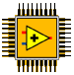
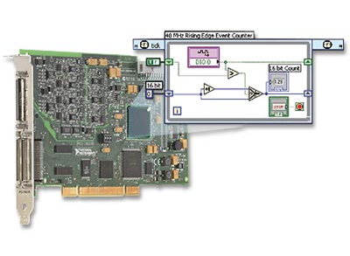
B. LabVIEW FPGA System
LabVIEW FPGA Module
NI-RIO Driver
Reconfigurable I/O (RIO) Hardware
Notes:
While FPGAs have many benefits, there are some challenges when developing FPGAs. Typically, FPGAs are programmed using hardware description language (HDL), such as VHDL or Verilog. These tools have steep learning curves and can become a barrier for using this technology. Additionally, these tools are often not intuitive for test and control engineers.
The LabVIEW FPGA Module allows LabVIEW to target FPGAs on NI Reconfigurable I/O hardware so scientists and engineers can take advantage of the performance and flexibility of FPGAs without needing to learn the low-level design tools. Therefore, the basic components of a LabVIEW FPGA system are the LabVIEW FPGA Module, the NI-RIO driver, and an NI-RIO device, also known as a RIO target.
Instructors: Point out the LabVIEW FPGA chip logo. This helps users know if they have LabVIEW FPGA installed – seen on LV Startup page. This symbol will also be used in subsequent slides to represent the LabVIEW FPGA module.

Slide 15
LabVIEW FPGA Module
Add-on module for LabVIEW
Develop VIs for FPGA target
Develop VIs for host PC or Real-Time interaction with FPGA
Notes:
LV FPGA module is add-on module for LabVIEW. Using the LabVIEW FPGA Module, you can develop custom control and measurement hardware without any prior knowledge of hardware description languages or board level hardware design. VIs created with the LabVIEW FPGA module can be targeted to the FPGAs on NI Reconfigurable I/O, or RIO, hardware. You can also create VIs for your host PC to interact with the FPGA target.

Slide 16
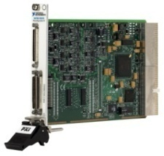
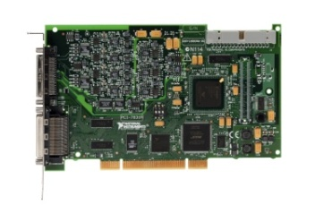
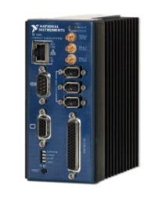
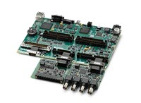
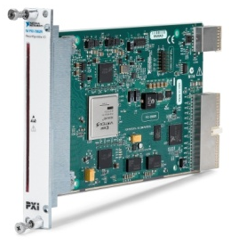
LabVIEW FPGA Targets
CompactRIO
PXI R Series Multifunction RIO
PCI R Series Multifunction RIO
Compact Vision System
Single-Board RIO
FlexRIO
RIO Instruments
Notes:
The following NI hardware platforms have a user-programmable FPGA:
CompactRIO is an embedded system that is used for machine control, in-vehicle data acquisition, and portable NVH applications.
The R Series is a family of general-purpose data acquisition devices. There are multiple versions of both PXI and PCI and include analog I/O and digital I/O.
The Compact Vision System (CVS) and 825x can acquire data from up to three IEEE 1394 FireWire® cameras and the CVS is a complete system for machine vision applications. This system also includes 29 digital lines whose functionality can be configured using LabVIEW FPGA.
FlexRIO is a target which allows you to create a custom device with user-defined I/O.
RIO Instruments are FPGA-enabled instruments such as the PXIe-5641R – which is a PC-based Intermediate Frequency (IF) transceivers that is used in RF dynamic tests, Software-Defined Radio (SDR), and user-defined IF applications.
Make sure that students realize that LabVIEW FPGA is not a general-purpose FPGA design tool for targeting standalone FPGAs. If users need more flexibility in defining the I/O, they should look into using the FlexRIO system.

Slide 17
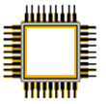
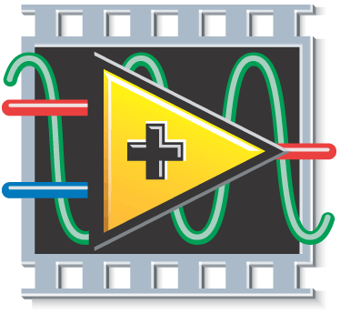
LabVIEW FPGA: How does it work?
LabVIEW FPGA
LabVIEW VI
Xilinx ISE Compiler
VHDL Constraints
LabVIEW FPGA
Bitfile
Xilinx FPGA Chip
User Generated
Auto Generated
Notes:
The LabVIEW FPGA module compiles your LabVIEW application to FPGA hardware through a compile process. Behind the scenes, your graphical code is translated to text-based VHDL code. Then, industry standard Xilinx ISE compiler tools are invoked and the VHDL code is optimized and synthesized into a hardware circuit realization of your LabVIEW design. This process also applies timing constraints to the design and tries to achieve an efficient use of FPGA resources (sometimes called “fabric”).
A great deal of optimization is performed during the FPGA compilation process to reduce digital logic and create an optimal implementation of the LabVIEW application. Then the design is synthesized into a highly optimized silicon implementation that provides true parallel processing capabilities with the performance and reliability of dedicated hardware.
The end result is a bitstream that contains the programming instructions LabVIEW downloads to the FPGA target. When you run the application, the bit stream is loaded into the FPGA chip and used to reconfigure the gate array logic. The bit stream can also be loaded into nonvolatile Flash memory and loaded instantaneously when power is applied to the FPGA target. There is no operating system on the FPGA chip, but you can control the FPGA chip through a host application.
Graphical LabVIEW FPGA code is translated to text-based VHDL code
Applies timing constraints on the circuit design
By default, the FPGA clock runs at 40 MHz
Xilinx ISE compiler tools are invoked
VHDL code is optimized
Logic is reduced
Gate array configuration is synthesized
Bit stream is loaded into the FPGA

Slide 18
Benefits of LabVIEW FPGA System
FPGA technology
Create custom hardware using LabVIEW
No Verilog/VHDL coding or board design
Direct access to hardware terminals
Extensive library of built-in functions
Integration with 3rd party IP
Tools to communicate, monitor and control the FPGA from Windows PC or Real-Time controller
Notes:
Besides all the benefits noted earlier of using FPGA, LabVIEW FPGA provides the following additional benefits:
Use LabVIEW to develop your FPGA custom hardware without VHDL coding or board design. Through the LV block diagram you have direct access to the hardware terminals.
LabVIEW has extensive library of built-in functions (FFT, Filters, signal generation, etc.). There are tools to integrate with 3rd party IP.
Use the LabVIEW environment and LabVIEW VIs to communicate with, monitor, and control the FPGA from a host PC or a real-time controller. Furthermore, LabVIEW FPGA handles many operations that are not natively handled on FPGAs – such as DMA transfers to processor, Ethernet communication for CompactRIO, data storage with special CompactRIO modules, and user interface interaction

Slide 19
C. Comparison with NI-DAQmx System
DAQmx System
LabVIEW
NI-DAQmx
Driver
M Series Device
User Defined
Vendor Defined
Notes:
To understand the paradigm of a LabVIEW FPGA system, it is important to understand the specific components found in a traditional measurement system. A traditional measurement and control system consists of three basic components:
The application software running in Windows or a Real-Time operating system (RTOS). For you, this would be the LabVIEW Development Environment.
The driver software and functions to interface to your hardware. This would be the NI-DAQmx driver.
And finally, the I/O hardware. For this specific example, we are calling out an M-series DAQ device.
With this paradigm, end users receive only the functionality that our developers designed into the ASIC of the M Series. Additionally, an extensive driver is required to make all of the device functionality accessible through software. The drawback to this approach is that all of the device functionality is fixed. The customization of such systems comes through the programming at the application software layer which can result in limitations of the hardware functionality and complex software driver calls to perform particular tasks.

Slide 20
LabVIEW FPGA System
LabVIEW FPGA System
LabVIEW
NI-RIO Driver
LabVIEW FPGA
RIO Hardware
User Defined
Vendor Defined
Notes:
Objective: Show how LabVIEW FPGA is different from a DAQ application, but also emphasize that it’s not too different from the technology they are already familiar with - it just adds an additional layer.
When using a LabVIEW FPGA-based measurement system, the paradigm changes. While you are still using COTS hardware from National Instruments, in this case the R Series DAQ device, you can now modify the hardware functionality of this device using LabVIEW FPGA. On the RIO hardware platforms, the FPGA (instead of an ASIC) defines the device functionality. You still have the application software running in Windows or on an RTOS, however, now there is a very thin driver called NI-RIO that provides the interface functions to our hardware. With this paradigm, end users have an I/O platform with the performance, flexibility, and customization of an FPGA without the added complexity of having to understand FPGA and board-level hardware design.

Slide 21
Decision Making in Software
Crash Possible
Traditional System
I/O
Operating System
Driver API
Application Software
Calculation
UUT
~25 μs
Response
Outputs
Notes:
Many test and control systems perform calculations in software. When executing in software the calculation must be performed after multiple software calls through the application software, driver API, and operating system before actually interfacing with the unit under test (UUT). Even when using an RTOS and optimized algorithms, the fastest response rate you can typically achieve in software is around 25 µs. Additionally, there is added vulnerability within a software-based system because a crash can occur at multiple levels that interfere with the response of the system.

Slide 22
Decision Making in Hardware
Highest Reliability
LabVIEW FPGA System
I/O
Calculation
Operating System
Driver API
Application Software
UUT
25 ns*
Response
Outputs
* Faster response for 80 and 120 MHz clocks
Notes:
When executing calculations in hardware, as with LabVIEW FPGA, you can remove software from the required response to the UUT. Under this configuration, LabVIEW FPGA can respond to digital signals within a single clock cycle. With a default clock rate of 40 MHz, LabVIEW FPGA can respond to a digital signal within 25 ns. You can compile LabVIEW FPGA code at higher rates in some cases.
Performing calculations in hardware provides the highest reliability possible because any crash at any software layer will not affect the execution of your code.

Slide 23
D. LabVIEW FPGA Applications
Typical LabVIEW FPGA applications
Intelligent DAQ
Custom Timing and Synchronization
Custom Counters
Multiple Scan Rates
Ultra-high speed control
Specialized communication protocols
Off-load CPU – Processing
Complex timing and synchronization
Hardware-in-the-Loop (HIL) testing
Notes:
D. LabVIEW FPGA Applications
Now, let’s look at some common applications that are well-suited for the LabVIEW FPGA Module.
LabVIEW FPGA is typically used for applications that require the development of custom hardware. These tasks include:
• Integrating custom timing, triggering, and synchronization
• Integrating a custom mix of analog I/O, digital I/O, counters, and
triggers into a single device
• Integrating custom digital communication protocols
• Parallel processing and data acquisition
• Custom motion control
• Off-loading signal processing
Intelligent DAQ - On-Board Processing:
NI’s R Series Intelligent DAQ devices are often used as alternatives for traditional DAQ applications when users need to customize the behavior.
Although we have lots of timing and synchronization options built into DAQmx and our DAQ products, sometimes you need to tweak them. Maybe instead of a single analog trigger line, you want to trigger off of two different analog signals at different thresholds. Or, maybe you want to control the acquisition start time based on an event not supported by our DAQ products.
Or maybe you need more counters than are typically supported on our multi-function DAQ cards. Maybe you need lots of counters. Instead of buying more boards, you can customize a digital board to be a bank of counters.
Maybe you want to acquire analog signals at different rates. With FPGA you could set a custom acquisition rate for each analog channel.
High-Speed Control:
Use single point I/O with PID or other control algorithms to implement onboard control with loop rates up to hundreds of KHz. You can acquire - process – and output data at higher speeds on the FPGA than to acquire data -- process on the host – and the output.
Digital Communications and Protocols:
Interface with standard and/or custom digital protocols.
Off-Load CPU Processing:
Communicate with direct memory access (DMA) by outsourcing the many processing algorithms that are well suited for FPGA hardware but CPU intensive on processor-based systems.
Complex Timing and Synchronization:
Implement complex triggering schemes, multi-rate acquisition, or supply clock signals to synchronize external devices.
Hardware-in-the-Loop (HIL) Testing:
Simulate sensors, emulate protocols, and implement important parts of HIL systems that are difficult to implement on processor-based systems.

Slide 24
Summary—Quiz
Which of the following are required software components of a LabVIEW FPGA system?
NI-RIO driver
DAQmx driver
LabVIEW Development System
LabVIEW Real-Time Module
LabVIEW FPGA Module

Slide 25
Summary—Quiz Answer
Which of the following are required software components of a LabVIEW FPGA system?
NI-RIO driver
DAQmx driver
LabVIEW Development System
LabVIEW Real-Time Module
LabVIEW FPGA Module
Notes:
DAQmx is not used to program RIO devices.
The LabVIEW Real-Time module is only needed if you are also using a Real-Time target such as CompactRIO. It is not needed when using an R-Series device. You will learn when the LabVIEW Real-Time module is required in the next lesson.

Slide 26
Summary—Quiz
What OS runs on the FPGA?
LabVIEW FPGA
MicroLinux
Unix
PharLap
None of the above

Slide 27
Summary—Quiz Answer
What OS runs on the FPGA?
LabVIEW FPGA
MicroLinux
Unix
PharLap
None of the above
Notes:
FPGAs do not use an operating system. This is why you can achieve parallelism offered by FPGAs.

Slide 28
Summary—Quiz
LabVIEW FPGA allows you to program an FPGA without knowing VHDL or HDL.
True
False

Slide 29
Summary—Quiz Answer
LabVIEW FPGA allows you to program an FPGA without knowing VHDL or HDL.
True
False
Notes:
Although there are ways of incorporating VHDL or HDL into a LabVIEW application, you do not need VHDL or HDL knowledge to program a LabVIEW FPGA system.

Slide 30
Summary—Quiz
Which of the following might be typical reasons for using R Series Multifunction RIO device over a DAQ board programmed with DAQmx?
Need more counters than available on a DAQ board
Need custom trigger logic
Need more analog input channels than available on a DAQ board
Need to simultaneously acquire data on different channels at different rates
Need a high-level/easy-to-use driver

Slide 31
Summary—Quiz Answers
Which of the following might be typical reasons for using R Series Multifunction RIO device over a DAQ board programmed with DAQmx?
Need more counters than available on a DAQ board
Need custom trigger logic
Need more analog input channels than available on a DAQ board
Need to simultaneously acquire data on different channels at different rates
Need a high-level/easy-to-use driver
Notes:
With FPGA you can turn a digital line into a counter. You are not limited to counters available in hardware.
With FPGA you can implement custom triggers that are not available through DAQmx or supported on the device.
You cannot increase the number of analog or digital channels by just going to an FPGA device. I/O are fixed for most RIO devices. With FlexRIO you do have some flexibility, but typically increasing number of analog input channels isn’t a reason to convert your application to using FPGA technology.
You can implement an application where each channel is acquiring data a different specified rates.
DAQmx provides a high-level API and will typically be easier to program than FPGA.

